Slide 1

Multi-Label Text Classification of Research Articles: Evaluating the Performance of Pretrained and Transformer Models
Sandeep Pandellapalli (psp5)
Maithili Lingala (msl10)

Slide 2
Agenda
Objective of the Study
Dataset Overview
EDA
Architecture
Comparative Analysis of ML models before Pre-Processing
Data Cleaning and Preprocessing
Comparative Analysis of ML models after Pre-Processing
BERT
Label Imbalance and overfitting
Results
Conclusion
References

Slide 3


Objective
To automate the categorization of research articles into relevant topics using advanced text mining techniques, aiming to improve the accuracy and accessibility of academic publication classification.

Slide 4
Dataset Overview
Name : Multi-Label Classification Dataset for Academic Articles
Features : ID, Title, Abstract
Labels : Computer Science, Physics, Mathematics, Statistics, Quantitative Biology, Quantitative Finance
Total entries : 20,972 research articles

Slide 5
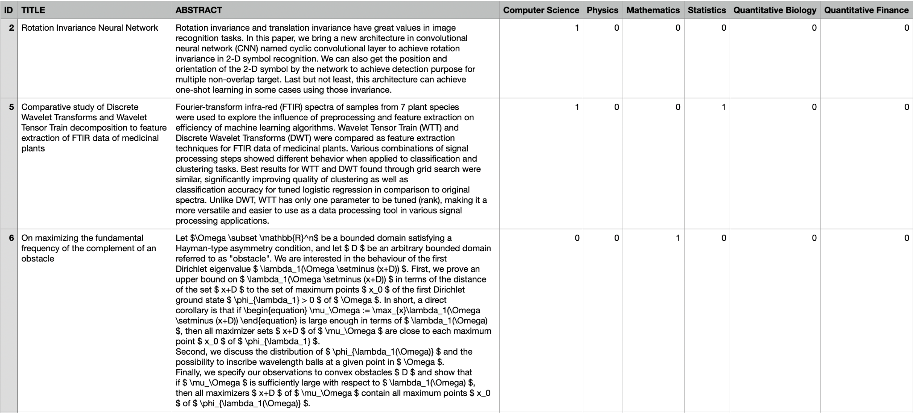
Dataset Example
5

Slide 6
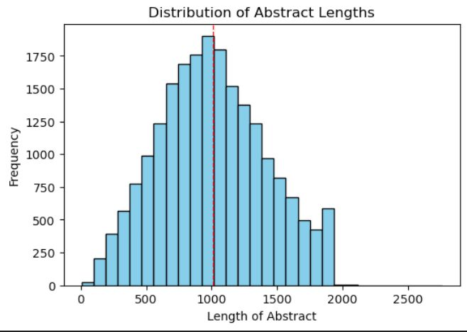
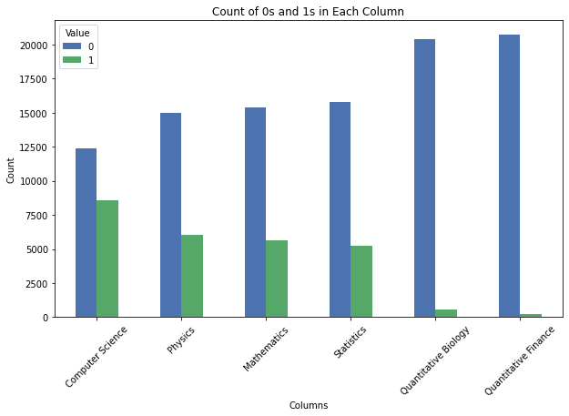
EDA

Slide 7
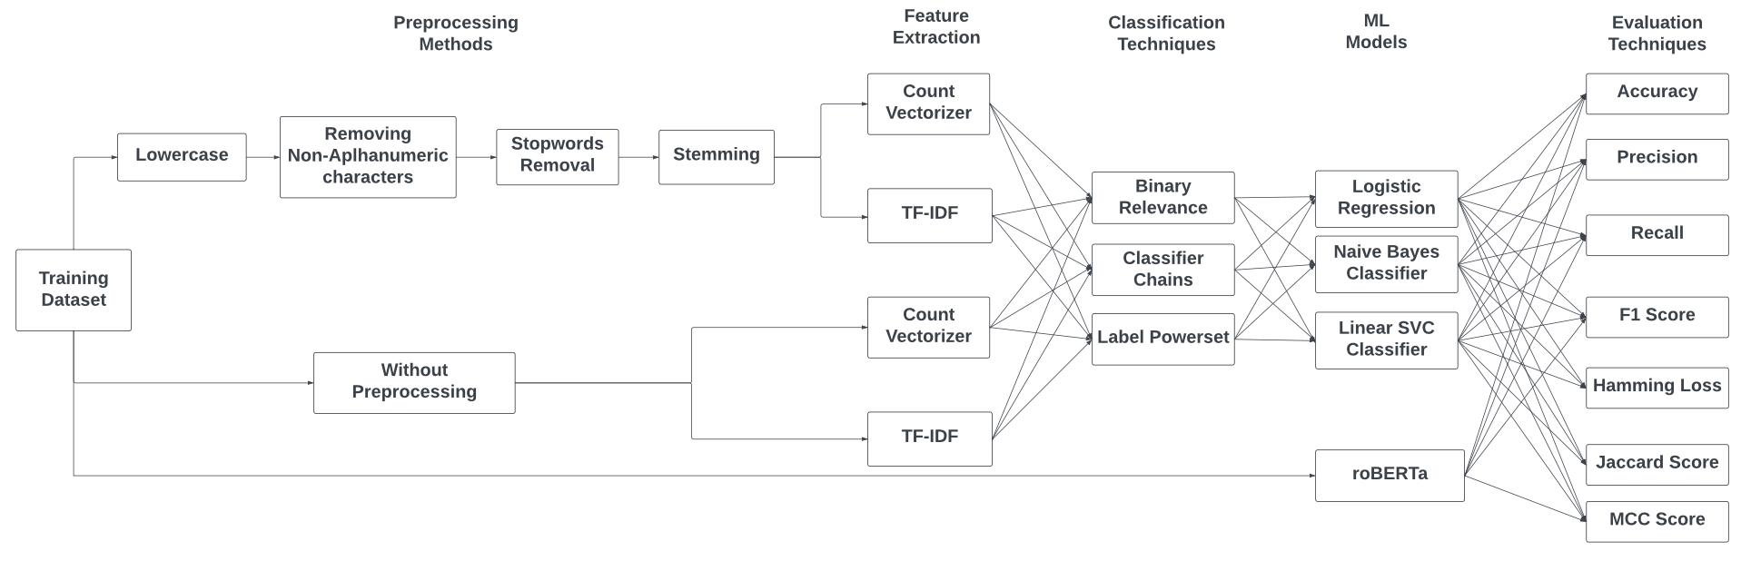
Architecture

Slide 8
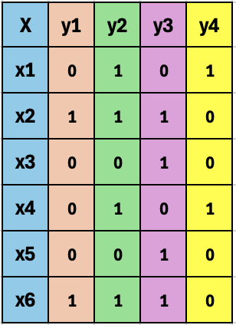
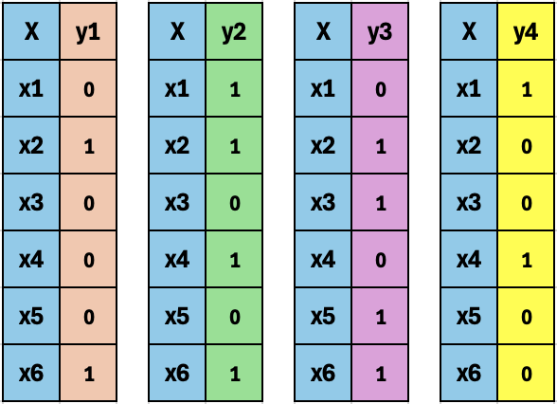
Binary Relevance
8

Slide 9
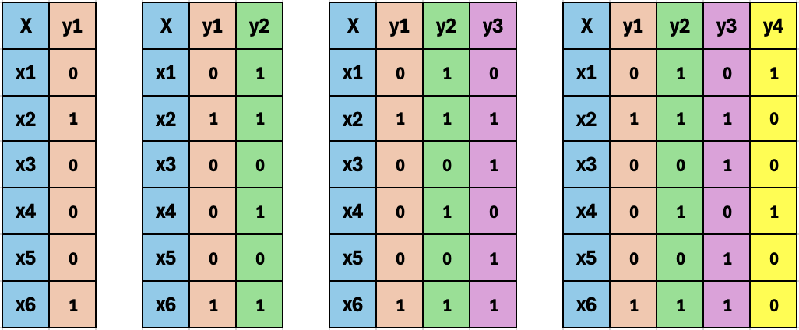
Classifier Chains
9

Slide 10
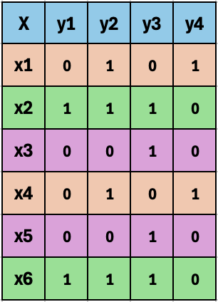
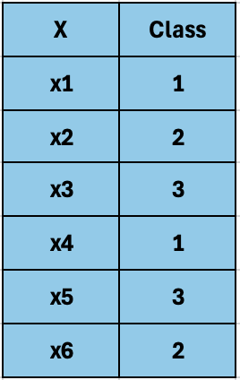
Label Powerset
10

Slide 11
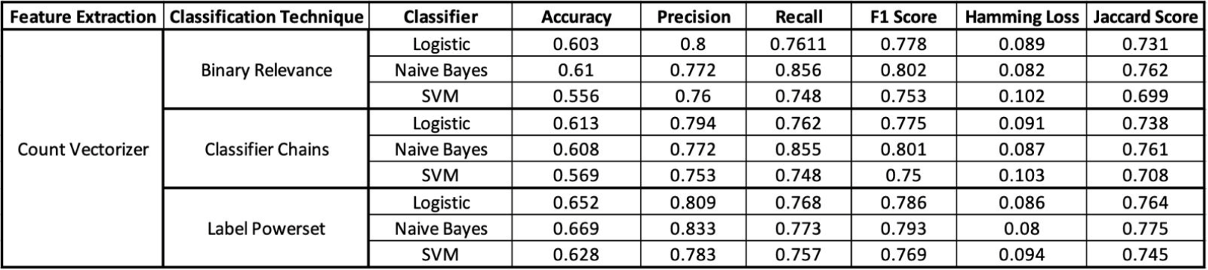
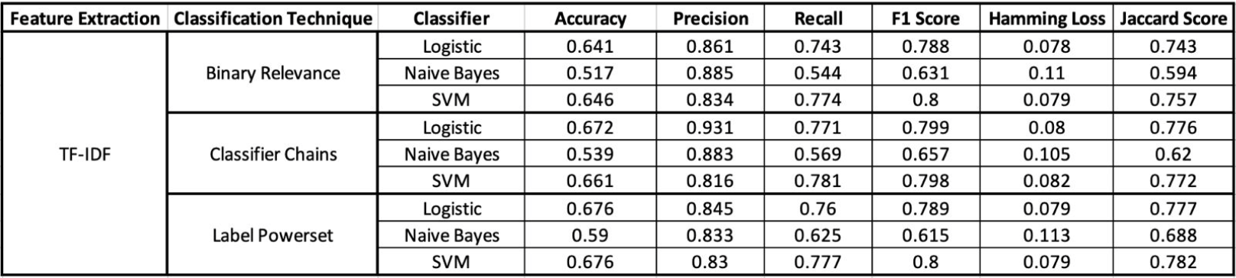
Comparative Analysis without Pre-Processing
11

Slide 12
Data Cleaning & Preprocessing Methods
Convert to Lowercase
text.lower()
Remove special characters
re.sub(r'[^a-zA-Z\s]', '', text)
Remove stop words
text.split() if not w in stop_words
join
Stemming
stemmer.stem(word)
Combining Title and Abstract
['Text' ]= ['TITLE'] + ['ABSTRACT']

Slide 13
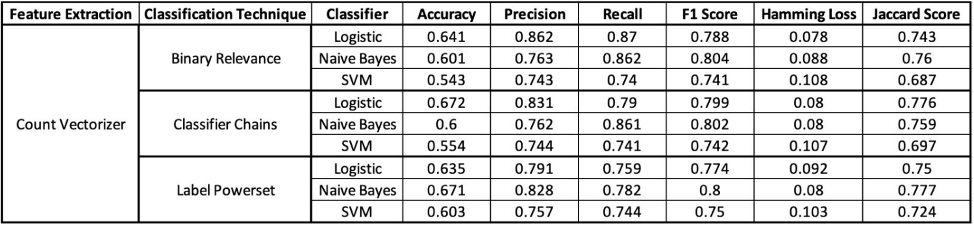
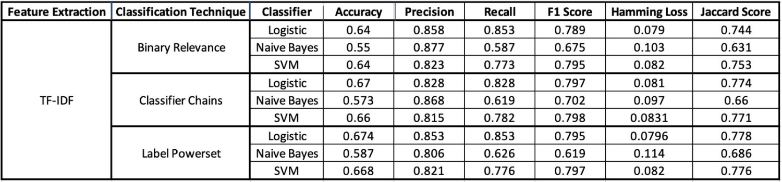
Comparative Analysis after Pre-Processing
13

Slide 14
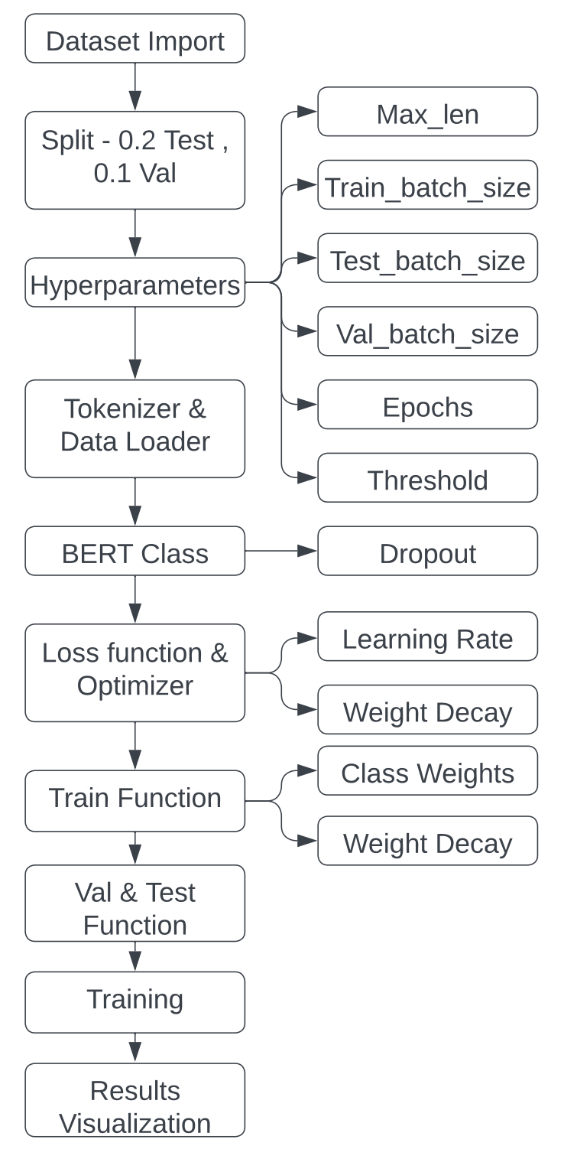
BERT
Robustly Optimized BERT Approach
Trained on 160GB of text
Over 10 times the size of the dataset used for BERT
RoBERTa does not use the next-sentence pretraining objective(no token_type_ids)
12 attention heads per layer. There are 12 layers in total, making for a total of 144 attention heads
14

Slide 15
Approaches followed to counter label imbalance and overfitting
torch.nn.Dropout(0.5)
Regularization technique used to prevent overfitting by randomly setting a fraction of input units
compute_class_weight('balanced', classes=np.array([0, 1]), y=df_train[column].values)
This mode automatically adjusts weights inversely proportional to class frequencies. This results in smaller classes getting a larger weight.
tensor([ 1.2246, 1.7311, 1.8822, 1.9967, 18.5037, 41.4808], device='cuda:0')
By capping the gradients, gradient clipping keeps the updates to weights manageable, preventing the weights from becoming too large or NaN during training iterations
clip_grad_norm_(model.parameters(), max_norm=1.0)
weight_decay = 3e-5
Regularization is decoupled from the adaptive rate, provides a consistent application of weight penalties across all parameters,
15

Slide 16
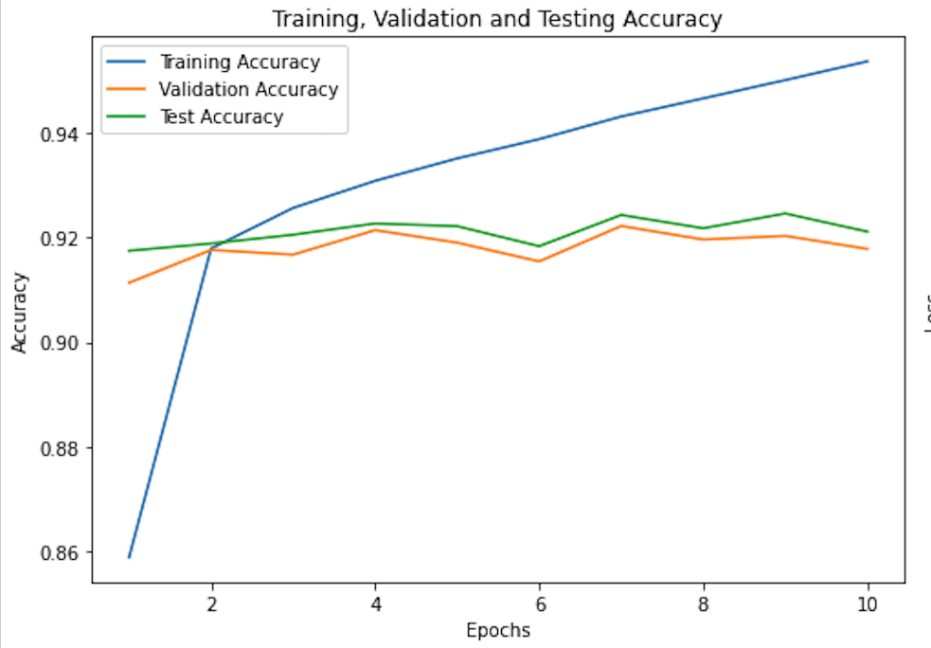
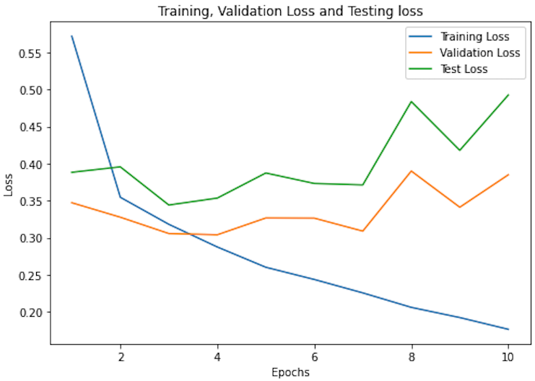
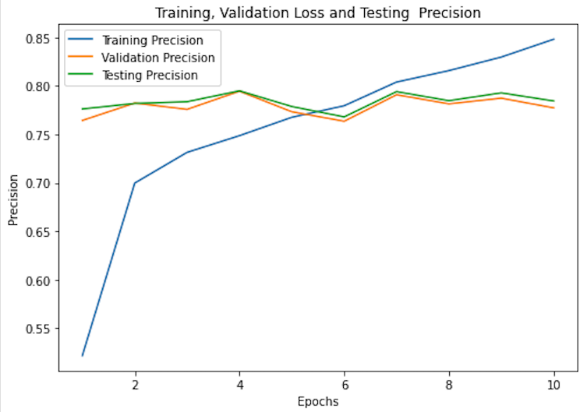
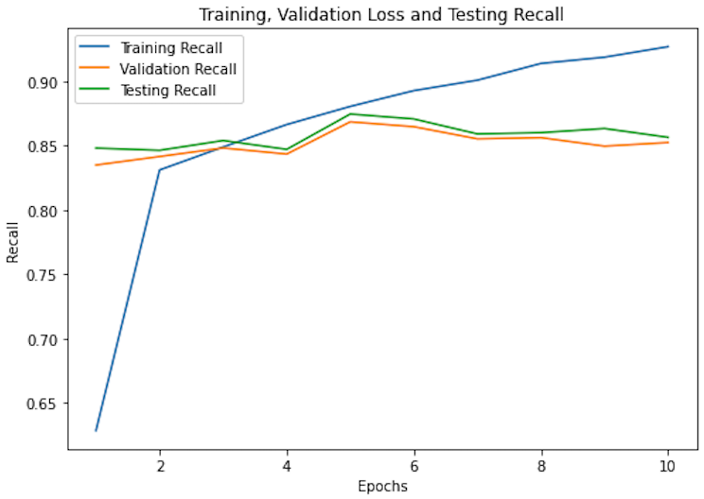
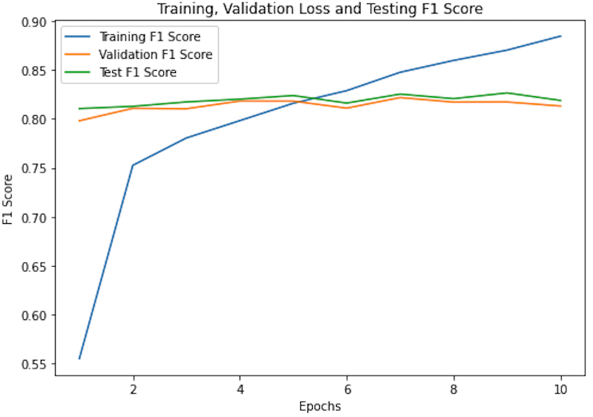
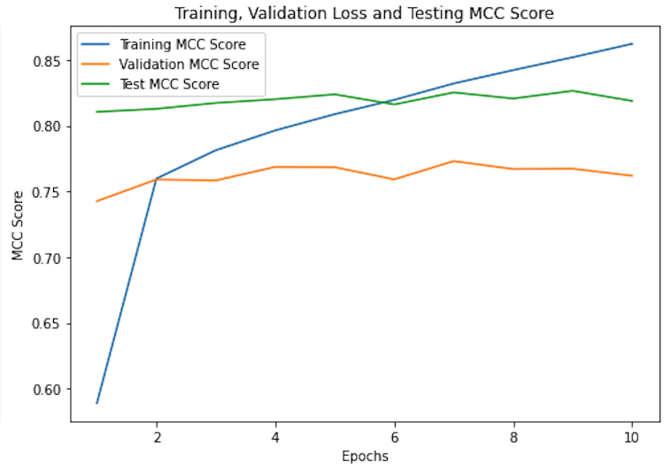
Results
16

Slide 17
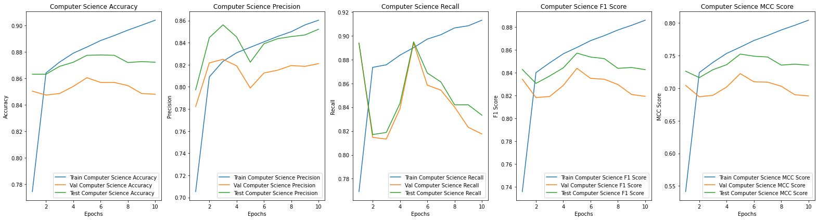
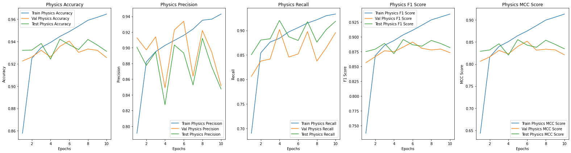
17

Slide 18
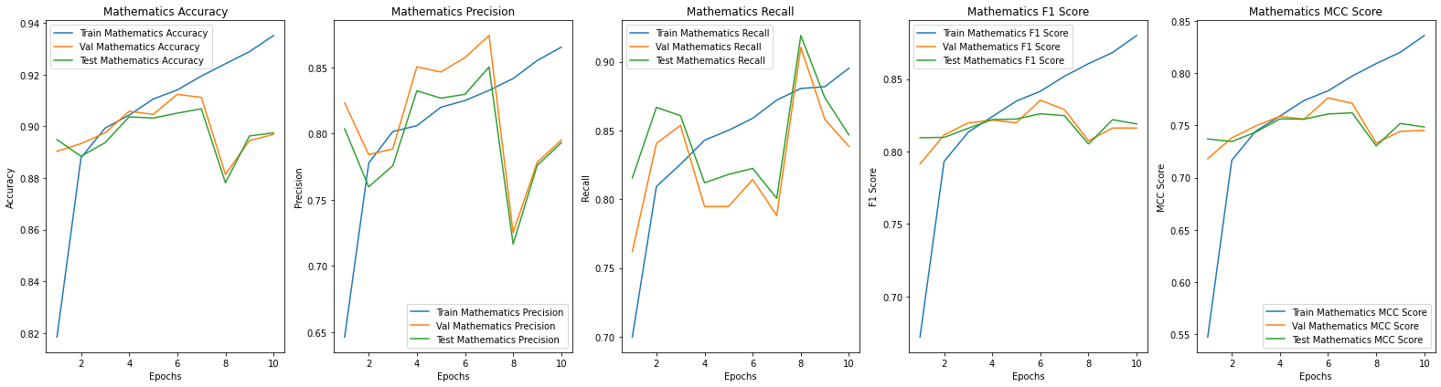
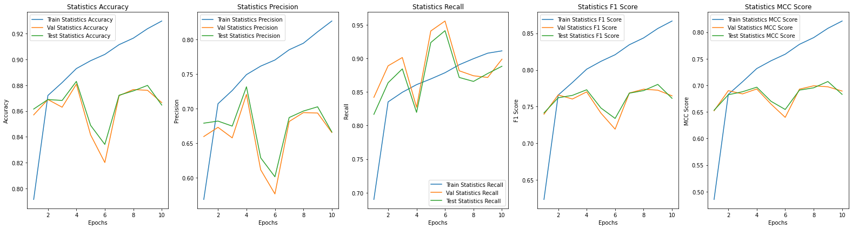
18

Slide 19
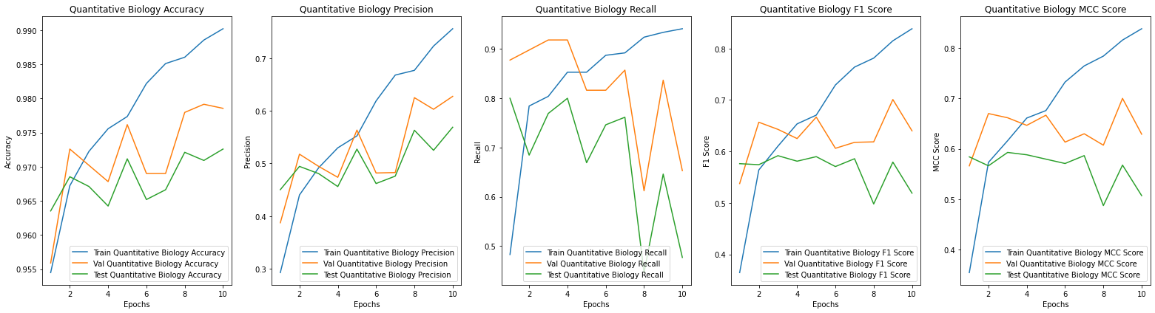
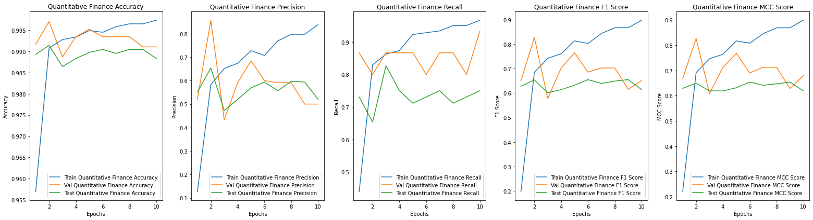
19

Slide 20
CONCLUSION & FUTURE SCOPE
Preprocessing Enhances Performance: Preprocessing improved all metrics across both feature extraction methods, with the most notable gains in accuracy, recall, and F1 score. TF-IDF combined with Logistic Regression consistently outperformed other combinations, achieving the best balance across metrics.
TF-IDF and Label Powerset Dominate: TF-IDF, paired with the Label Powerset technique, delivered the highest overall performance both before and after preprocessing, highlighting its effectiveness in capturing meaningful text features for multilabel classification.
Fluctuations in few labels: Across various categories, high training accuracy and improvements in F1 score and MCC indicate effective learning. However, significant variability in test performance, particularly in Physics, Statistics, Quantitative Biology and Quantitative Finance suggests potential overfitting, underscoring the challenge of achieving effective generalization to unseen data without adopting biases from training set.
Original sentence : “International crop trade networks: The impact of shocks and cascades”
Paraphrased sentence : “Global agricultural trade networks: Effects of disruptions and ripple effects”
20

Slide 21
References
N. K. Mishra and P. K. Singh, “Feature construction and SMOTE-based imbalance handling for multi-label learning,” Journal of Computational Science, vol. 54, p. 101468, 2021. doi: 10.1016/j.jocs.2021.101468.
B. R. Bhamare and J. Prabhu, “A multilabel classifier for text classification and enhanced BERT system,”ResearchGate, 2021. https://www.researchgate.net/publication/351880052_A_Multilabel_Classifier_for_Text_Classification_and_Enhanced_BERT_System.
J. Nam, J. Kim, E. Loza Menc, I. Gurevych,and J. Furnkranz, “Large-scale multi-label text classification — Revisiting neural networks,”ResearchGate, 2013. https://www.researchgate.net/publication/259367487_Large-Scale_Multi-label_Text_Classification_-_Revisiting_Neural_Networks.
A. Y. Taha, S. Tiun, A. H. Abd Rahman, and A. Sabah, “Multilabel over-sampling and under-sampling with class alignment for imbalanced multilabel text classification,” ResearchGate, 2021. https://www.researchgate.net/publication/352563832_Multilabel_Over-sampling_and_Under-sampling_with_Class_Alignment_for_Imbalanced_Multilabel_Text_Classification.
S. M. Liu and J. H. Chen, “A multi-label classification based approach for sentiment classification,”Expert Systems with Applications, vol. 41, no. 5, pp.2526-2535, 2015.
21

Slide 22

THANK YOU
22

